Slide 1

DevOps
Use this cover for most presentations
To replace the current photo, click on it and hit “delete.” Drag your new image into the photo placeholder box.
Click here to access photo library.
Photos may feature:
Employees
People benefiting from our solutions
A human element, such as a close up of a hand or a person in the distance
Workstream Project Plan
Innovation center, Washington, D.C.
April 2017

Slide 2
Guiding Principles
Additional layout options can be found in the master pages or in the Wide Slide Library
Everything as a service
Interchangeable components
DevOps visibility

Slide 3
Features of devops – Key areas
Additional layout options can be found in the master pages or in the Wide Slide Library
Continuous integration and deployment
Scalability and performance
Fault tolerance and catastrophe-preparedness
Security and monitoring
Deployment to an agency

Slide 4
Tool Stack
Environment
CI/CD Platform – Jenkins
Container PaaS – OpenShift
Infrastructure – AWS
Version Control - git
Security
Code Scans - SonarQube
Image Scans – Aqua Scanner
Application Scanning - Arachni
Database Testing – SQL-MAP/Arachni
Infrastructure Scanning – Open VAS
Monitoring
ELK Stack:
Elasticsearch
Logstash
Kibana
Development Tech stack
Services – Springboot, Angular
Rules Engine – Drools
Event Processing – Kafka/Confluent
API Management – Swagger, Kong/3Scale
Data Virtualization – Teiid

Slide 5
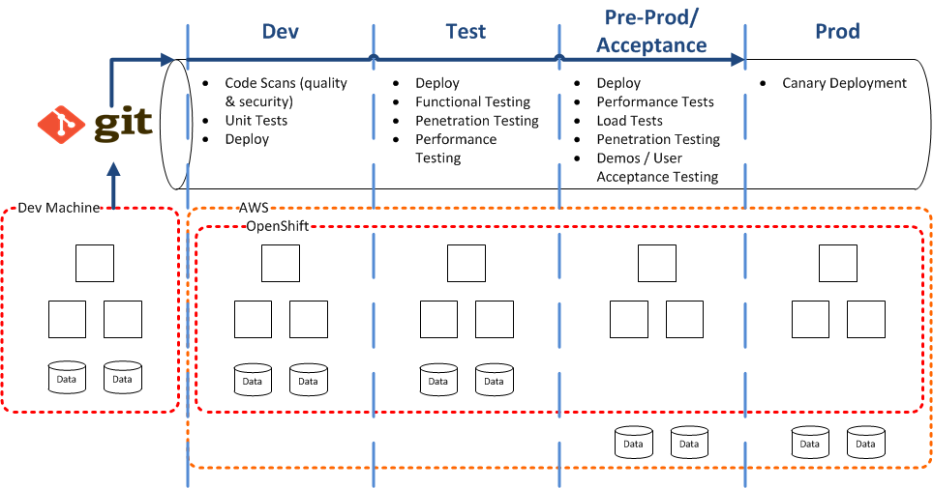
Continuous integration and deployment
Tools
CI/CD Platform – Jenkins
Container PaaS – OpenShift
Infrastructure – AWS
Version Control - git

Slide 6
Scalability and performance
Jenkins
Multi-Tenancy
Level 2 is a nested bullet
Level 2 is a nested bullet
Jenkins
Openshift
OpenShift Magic
Level 2 is a nested bullet
Level 2 is a nested bullet
AWS Magic
Level 2 is a nested bullet
Level 2 is a nested bullet

Slide 7
Fault Tolerance and Catastrophe-Preparedness
Three Pronged Approach
Staying Up – High Availability
Getting Back Up – Recovery: Backups and Scripting
Rectify – Extensive Audits and Logs
Development
Automate getting the applications up
Operations
Scripted AWS configuration
Scripted deployment and OpenShift and Jenkins clusters
Scripted configuration of OpenShift and Jenkins clusters

Slide 8
Security And Monitoring
Security
Code Scans - SonarQube
Image Scans – Aqua Scanner
Application Scanning - Arachni
Database Testing – SQL-MAP/Arachni
Infrastructure Scanning – Open VAS
Monitoring
ELK Stack

Slide 9
Governance and monitoring
Governance Suggestions
Team Roles
CI/CD – pipeline architecture enforces software engineering processes, policies and regulations
Microservice Documentation Standards
Microservice Development Standards
Monitoring, monitoring, monitoring
Dashboards
Actionable Alerts
Development
Pipeline Status Dashboard
Service Health Dashboard
Agile Development Boards
Microservice Production-Readiness Dashboard
Operations
Pipeline Status
Infrastructure Health
Node Alarms and Load Notifications
Automated Responses and Elevation

Slide 10
Deployment to an agencY
People
Manual → Automation - Retraining Staff
On-boarding Guides
Tie in change staff into the pipeline configuration process
Manual intervention is replaced with automated response and escalation notifications
Infrastructure
Standing up minimum viable environment
Deployment Scripts
Using hardened base images
Ability to use tools that are already at the agency
Policy
Automation of policy enforcement with the pipeline architecture
Being able to prove that

Slide 11
DevOps WorkStream
Client Objectives
Continuous Integration and Deployment
Scalability and Performance
Fault Tolerance and Catastrophe-Preparedness
Security and Monitoring
Deployment to an Agency
DevOps Key task areas
Infrastructure Configuration
Configuring Jenkins for HA
Scripted Deployment of OS and Jenkins
Scripted Configuration of OS and Jenkins
Tool Installation (Security, Testing and Monitoring)
Configuring OpenShift as a secure deployment environment
Configuring OpenShift and AWS for Horizontal HA
Development Support
Standing up tools
Setting up new services
Migration of legacy services into new environment
Standing up databases in new environments
Scripting database reset and test data populations
Configuring services for Scaling and Availability

Slide 12
DevOps WorkStream (Cont.)
Client Objectives
Continuous Integration and Deployment
Scalability and Performance
Fault Tolerance and Catastrophe-Preparedness
Security and Monitoring
Deployment to an Agency
DevOps Key task areas
Pipeline Development
Security Stages
Testing Stages
Templates for Service Types
Development Environment Provisioning
Adding Enhancements to the Pipelines (resource provisioning)
Ongoing Elimination of Technical Debt
Pipeline Architecture Development
DevOps: Monitoring/Dashboards/Governance
Develop Team Roles
Configuring Tools for Monitoring and Dashboards
Detailed Guides
Microservice ‘production readiness’ Dashboards
Infrastructure Diagrams

Slide 13
BackUP Slides
https://github.boozallencsn.com/JHT-ACCT-GROUP/bahgmm-docs/projects/1
https://pages.github.boozallencsn.com/JHT-ACCT-GROUP/bahgmm-docs/

Slide 14
DevOps WorkStream Agency Demo: Goals
Infrastructure
Jenkins Users
OpenShift Users
ELK Stack for Logging/Monitoring
Developer Support
All services configured and deployed in Dev/Test/Pre-Prod
Running Kafka Message Broker
Pipeline
Dev/Test/Pre-Prod Pipeline Deployment
Test Stages:
Unit
Lint
Coverage
Functional
UI Tests
Security Stages:
Code Scan
Container Image Scan
End Point Tests
Devops
Pipeline Status Dashboards per user Role (in Jenkins)
Service Status Dashboard (ELK Stack)
Service templates for Spring and NodeJS/Angular services
Demo creating of a new service)
Pipeline Development Status Dashboard
Microservice Production Readiness Dashboard

Slide 15
DevOps WorkStream Agency Demo: Scenarios
Adding a New Service
Modifying a service
Blue-Green Deployment
Introducing Errors into the code, show pipeline response (blocking deployment and rollback functionality)
Changing quality gates for a service
Service Scaling
Load the service
Configure autoscaling
Configure autoscaling limits
Throw alerts are the limits are approached

Slide 16
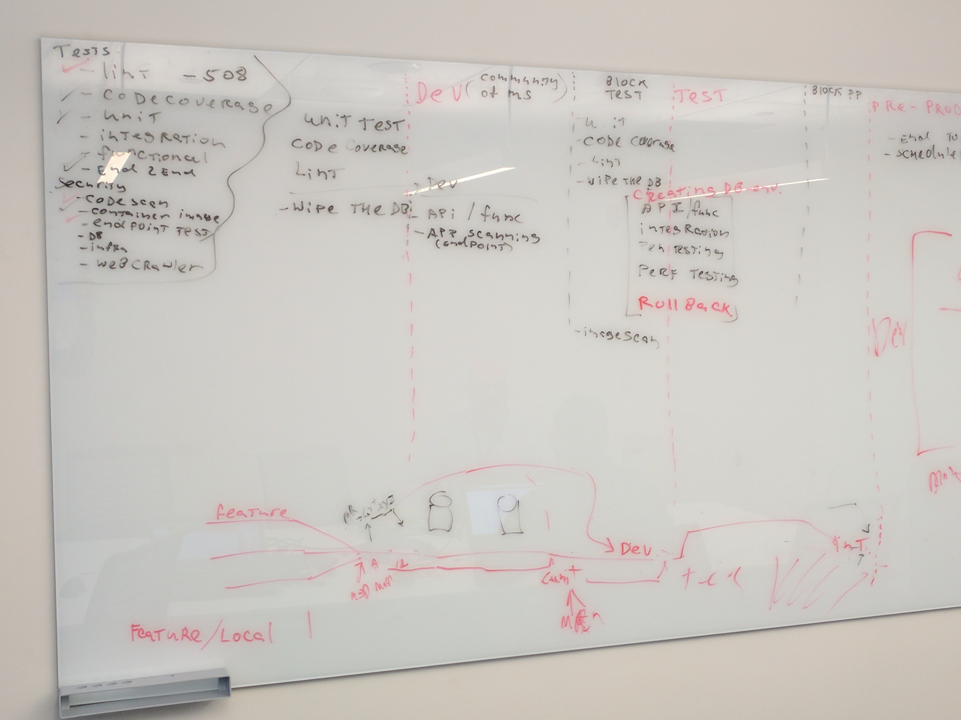
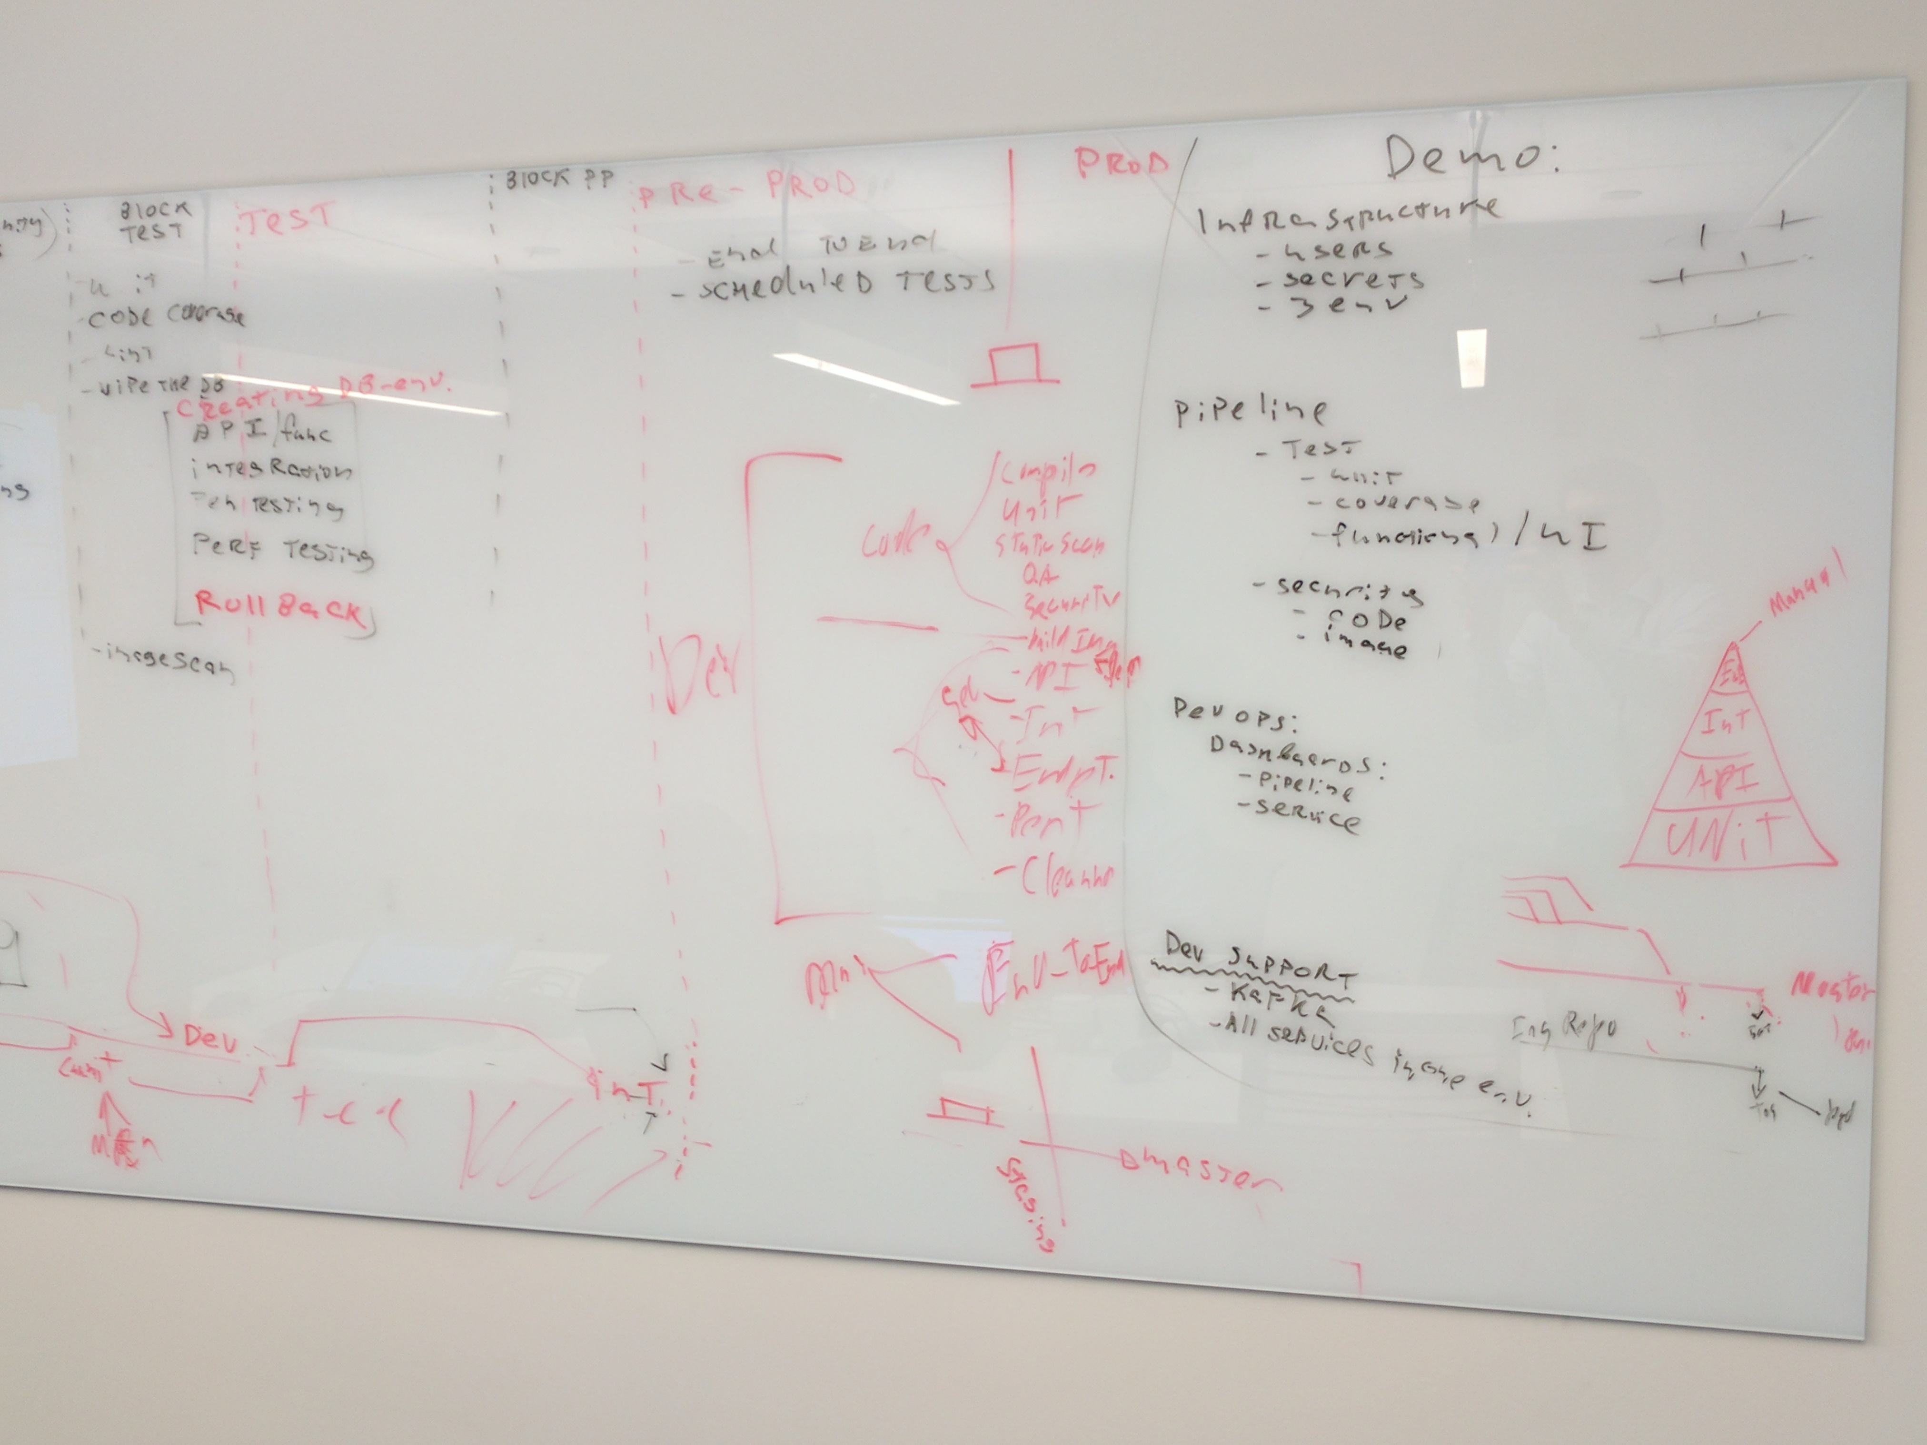
Branching Strategy

